Slide 1


Animation
Chris Piech
CS106A, Stanford University
This is Method Man. He is part of the Wu Tang Clan. ☺

Slide 2

Learning Goals
Feel more confident writing methods
Write animated programs

Slide 3
You will be able to write Bouncing Ball

Slide 4

Defining a Method
private void turnRight() {
turnLeft();
turnLeft();
turnLeft();
}

Slide 5

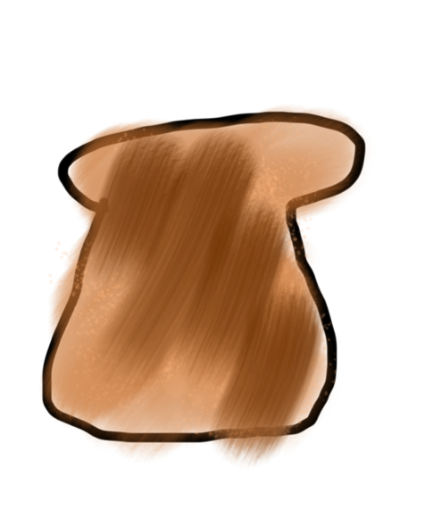
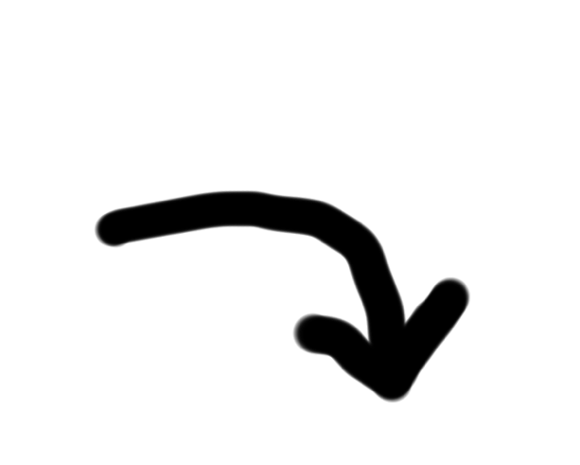
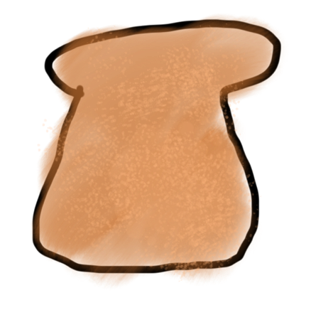
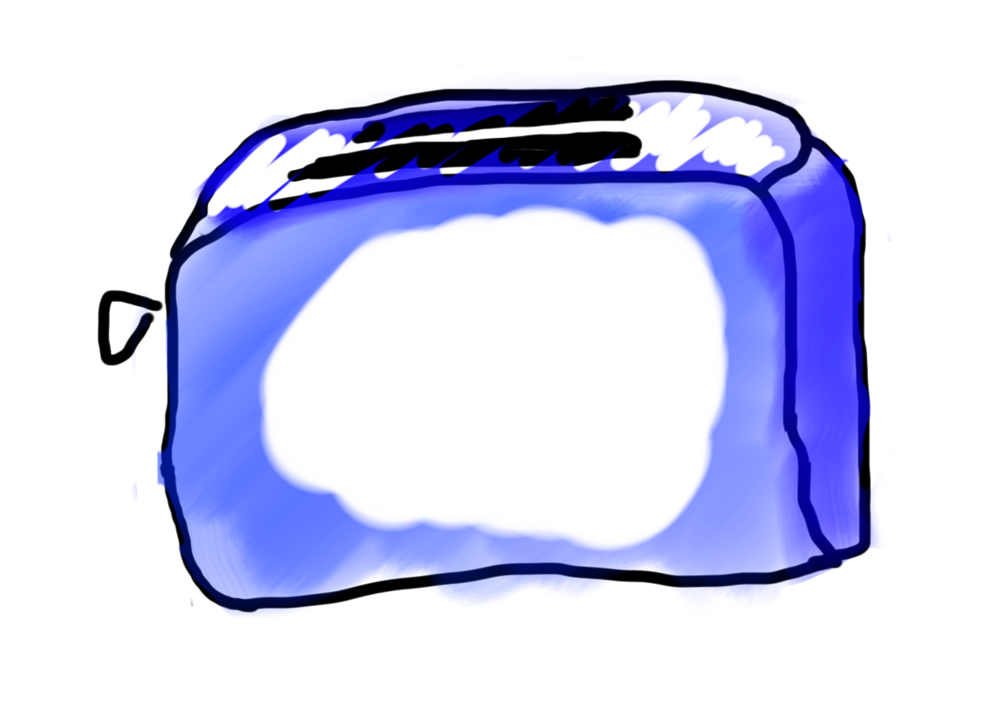
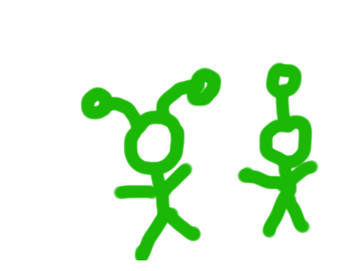
Methods are Like Toasters
parameter(s)
return

Slide 6
Anatomy of a method
public void run() {
double mid = average(5.0, 10.2);
println(mid);
}
private double average(double a, double b) {
double sum = a + b;
return sum / 2;
}

Slide 7
Anatomy of a method
public void run() {
double mid = average(5.0, 10.2);
println(mid);
}
private double average(double a, double b) {
double sum = a + b;
return sum / 2;
}
method “definition”

Slide 8
Anatomy of a method
public void run() {
double mid = average(5.0, 10.2);
println(mid);
}
private double average(double a, double b) {
double sum = a + b;
return sum / 2;
}
Return Type
Parameters
Do not confuse return type with println. Both are “outputs” of sort.

Slide 9
Anatomy of a method
public void run() {
double mid = average(5.0, 10.2);
println(mid);
}
private double average(double a, double b) {
double sum = a + b;
return sum / 2;
}
name

Slide 10
When passing inputs to methods:
Copies are passed.
Via new variables.
The method definition names the new variables.

Slide 11
Drawing Flags

Slide 12
Flags
private void drawColombiasFlag() {
// Call drawStripe three times
// with different inputs each time
drawStripe(Color.YELLOW, 0); drawStripe(Color.BLUE, 0.5); drawStripe(Color.RED, 0.75);
}
// Define drawStripe
// drawStripe needs two inputs (which come as variables)
// First a color, then a fraction down the screen
private void drawStripe(Color color, double fractionDown) {
double y = getHeight() * fractionDown;
GRect rect = new GRect(0, y, getWidth(), getHeight() - y);
rect.setColor(color);
rect.setFilled(true);
add(rect);
}
method “definition”

Slide 13
Flags
private void drawColombiasFlag() {
// Call drawStripe three times
// with different inputs each time
drawStripe(Color.YELLOW, 0); drawStripe(Color.BLUE, 0.5); drawStripe(Color.RED, 0.75);
}
// Define drawStripe
// drawStripe needs two inputs (which come as variables)
// First a color, then a fraction down the screen
private void drawStripe(Color color, double fractionDown) {
double y = getHeight() * fractionDown;
GRect rect = new GRect(0, y, getWidth(), getHeight() - y);
rect.setColor(color);
rect.setFilled(true);
add(rect);
}
Takes two inputs: (1) a color, (2) a fraction

Slide 14
Flags
private void drawColombiasFlag() {
// Call drawStripe three times
// with different inputs each time
drawStripe(Color.YELLOW, 0); drawStripe(Color.BLUE, 0.5); drawStripe(Color.RED, 0.75);
}
Thus, every time the method is called, two inputs must be given!
// Define drawStripe
// drawStripe needs two inputs (which come as variables)
// First a color, then a fraction down the screen
private void drawStripe(Color color, double fractionDown) {
double y = getHeight() * fractionDown;
GRect rect = new GRect(0, y, getWidth(), getHeight() - y);
rect.setColor(color);
rect.setFilled(true);
add(rect);
}

Slide 15
Flags
private void drawColombiasFlag() {
// Call drawStripe three times
// with different inputs each time
drawStripe(Color.YELLOW, 0); drawStripe(Color.BLUE, 0.5); drawStripe(Color.RED, 0.75);
}
The method receives the first input in a box (aka as a variable), with the name color
// Define drawStripe
// drawStripe needs two inputs (which come as variables)
// First a color, then a fraction down the screen
private void drawStripe(Color color, double fractionDown) {
double y = getHeight() * fractionDown;
GRect rect = new GRect(0, y, getWidth(), getHeight() - y);
rect.setColor(color);
rect.setFilled(true);
add(rect);
}
It can use the value in the color variable

Slide 16
Flags
private void drawColombiasFlag() {
// Call drawStripe three times
// with different inputs each time
drawStripe(Color.YELLOW, 0); drawStripe(Color.BLUE, 0.5); drawStripe(Color.RED, 0.75);
}
The method receives the second input in a box (aka as a variable), with the name fractionDown
// Define drawStripe
// drawStripe needs two inputs (which come as variables)
// First a color, then a fraction down the screen
private void drawStripe(Color color, double fractionDown) {
double y = getHeight() * fractionDown;
GRect rect = new GRect(0, y, getWidth(), getHeight() - y);
rect.setColor(color);
rect.setFilled(true);
add(rect);
}
It can use the value in the fractionDown variable

Slide 17
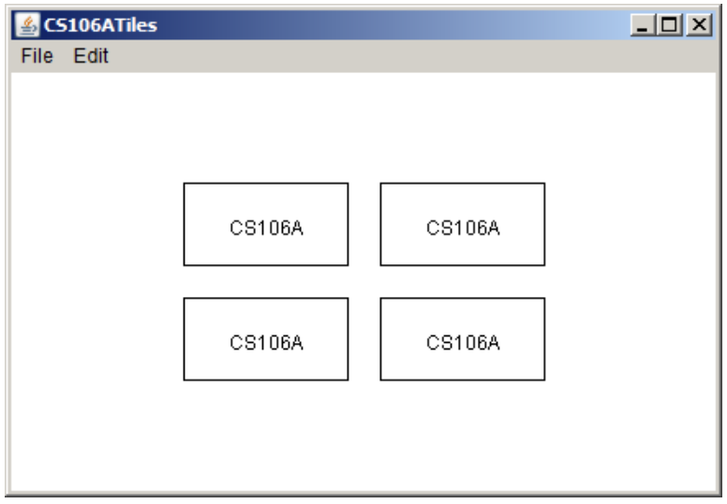
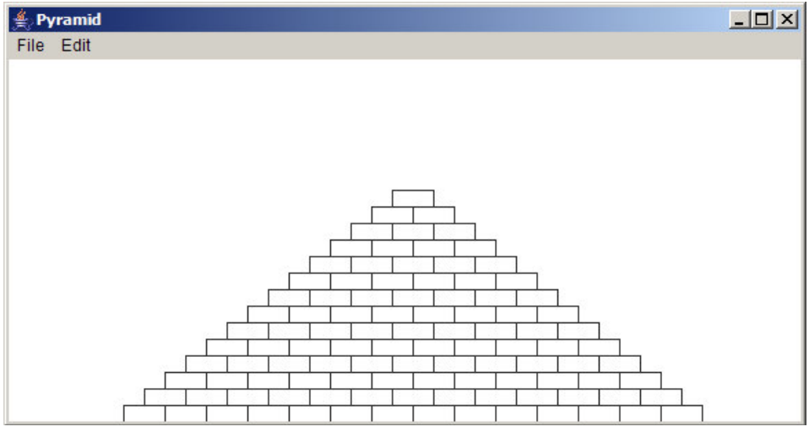
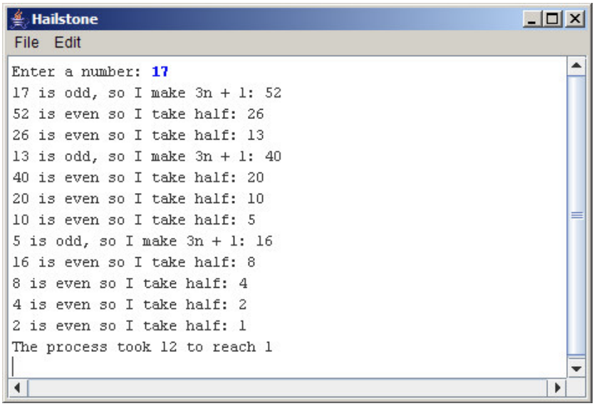
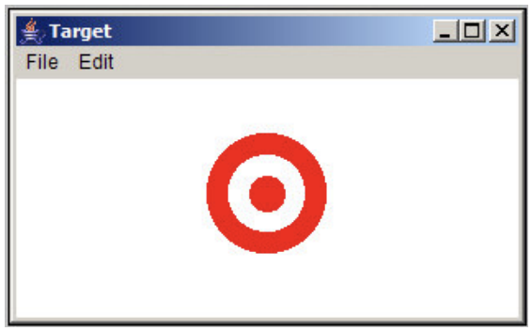
Assn 2
Absolutely
Not necessary
Yes
Odd test?

Slide 18
As we left off..

Slide 19
Changed Name
private void run() {
int num = 5;
cow(num);
}
private void cow(int grass) {
println(grass);
}

Slide 20
Changed Name
run
private void run() {
int num = 5;
cow(num);
}
private void cow(int grass) {
println(grass);
}
num
5

Slide 21
Changed Name
run
private void run() {
int num = 5;
cow(num);
}
private void cow(int grass) {
println(grass);
}
num
5

Slide 22
Changed Name
run
private void run() {
int num = 5;
cow(num);
}
private void cow(int grass) {
println(grass);
}
num
5
cow
grass
5

Slide 23
Changed Name
run
private void run() {
int num = 5;
cow(num);
}
private void cow(int grass) {
println(grass);
}
num
5
cow
grass
5

Slide 24
Changed Name
run
private void run() {
int num = 5;
cow(num);
}
private void cow(int grass) {
println(grass);
}
num
5
cow
grass
5

Slide 25
Same Variable Name
private void run() {
int money = 5;
retireEarly();
println(money);
}
private void retireEarly(){
int money = 1200000;
println(money);
}

Slide 26
Same Variable Name
run
private void run() {
int money = 5;
retireEarly();
println(money);
}
private void retireEarly(){
int money = 1200000;
println(money);
}
money
5

Slide 27
Same Variable Name
run
private void run() {
int money = 5;
retireEarly();
println(money);
}
private void retireEarly(){
int money = 1200000;
println(money);
}
money
5

Slide 28
Same Variable Name
run
private void run() {
int money = 5;
retireEarly();
println(money);
}
private void retireEarly(){
int money = 1200000;
println(money);
}
money
5
retireEarly

Slide 29
Same Variable Name
run
private void run() {
int money = 5;
retireEarly();
println(money);
}
private void retireEarly(){
int money = 1200000;
println(money);
}
money
5
retireEarly
money
1200000

Slide 30
Same Variable Name
run
private void run() {
int money = 5;
retireEarly();
println(money);
}
private void retireEarly(){
int money = 1200000;
println(money);
}
money
5
retireEarly
money
1200000
1200000

Slide 31
Same Variable Name
run
private void run() {
int money = 5;
retireEarly();
println(money);
}
private void retireEarly(){
int money = 1200000;
println(money);
}
money
5
retireEarly
money
1200000
1200000

Slide 32
Same Variable Name
run
private void run() {
int money = 5;
retireEarly();
println(money);
}
private void retireEarly(){
int money = 1200000;
println(money);
}
money
5
1200000
5

Slide 33

No Methods in Methods
private void run() {
println(“hello world”);
private void sayGoodbye() {
println(“goodbye!”);
}
}
Illegal modifier for parameter goodbye, only final is permitted
Huh?!?

Slide 34
No Methods in Methods
private void run() {
println(“hello world”);
sayGoodbye();
}
private void sayGoodbye() {
println(“goodbye!”);
}

Slide 35
Remember Booleans?

Slide 36
Boolean Variable
boolean karelIsAwesome = true;
boolean myBool = 1 < 2;

Slide 37
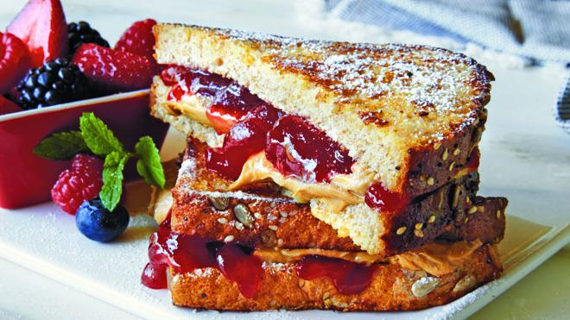

Slide 38
Is Divisible By
private void run() {
for(int i = 1; i <= 100; i++) {
if(isDivisibleBy(i, 7)) {
println(i);
}
}
}

Slide 39
Boolean Return
private void run() {
for(int i = 1; i <= 100; i++) {
if(isDivisibleBy(i, 7)) {
println(i);
}
}
}
private boolean isDivisibleBy(int a, int b) {
if((a % b) == 0) {
return true;
} else {
return false;
}
}

Slide 40
private void run() {
for(int i = 1; i <= 100; i++) {
if(isDivisibleBy(i, 7)) {
println(i);
}
}
}
private boolean isDivisibleBy(int a, int b) {
return a % b == 0;
}
Boolean Return

Slide 41
Methods are broccoli

Slide 42
Move to Center

Slide 43
Animation Loop
private void run() {
// setup
while(true) {
// update world
// pause
pause(DELAY);
}
}

Slide 44
Animation Loop
private void run() {
// setup
while(true) {
// update world
// pause
pause(DELAY);
}
}
Make all the variables you need. Add graphics to the screen.

Slide 45
Animation Loop
private void run() {
// setup
while(true) {
// update world
// pause
pause(DELAY);
}
}
The animation loop is a repetition of heartbeats

Slide 46
Animation Loop
private void run() {
// setup
while(true) {
// update world
// pause
pause(DELAY);
}
}
Each heart-beat, update the world forward one frame

Slide 47
Animation Loop
private void run() {
// setup
while(true) {
// update world
// pause
pause(DELAY);
}
}
If you don’t pause, humans won’t be able to see it

Slide 48
Move To Center
private void run() {
// setup
GRect r = makeRect();
while(!isPastCenter(r))
// update world
r.move(1, 0);
// pause
pause(DELAY);
}
}

Slide 49
Bouncing Ball

Slide 50
Milestone #1

Slide 51
Bouncing Ball
First heartbeat
Velocity: how much the ball position
changes each heartbeat

Slide 52
Bouncing Ball
First heartbeat
vx
vy
The GOval move method takes in
a change in x and a change in y

Slide 53
Bouncing Ball
Second heartbeat
vx
vy

Slide 54
Bouncing Ball
Third heartbeat
vx
vy

Slide 55
Bouncing Ball
What happens when we hit a wall?

Slide 56
Bouncing Ball
We have this velocity
vx
vy

Slide 57
Bouncing Ball
Our new velocity
vy
vx
When reflecting vertically: vy = -vy

Slide 58
Bouncing Ball
Seventh heartbeat
vy
vx

Slide 59
Bouncing Ball
Eighth heartbeat
vy
vx

Slide 60
Bouncing Ball
Ninth heartbeat
vy
vx

Slide 61
Bouncing Ball
We want this!

Slide 62
Bouncing Ball
This was our old velocity
vy
vx

Slide 63
Bouncing Ball
This is our new velocity
vy
vx
When reflecting horizontally: vx = -vx

Slide 64
Bouncing Ball
Tenth heartbeat
vy
vx
When reflecting horizontally: vx = -vx

Slide 65
Bouncing Ball

Slide 66
A Sticky Situation
This is our new velocity
The ball is above the bottom so we reverse its vy
The ball is bellow the bottom so we reverse its vy

Slide 67
Learning Goals
Feel more confident writing methods
Write animated programs

